Slide 1
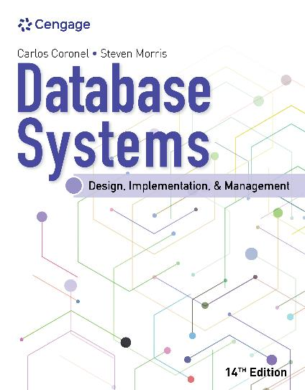
Database Systems: Design, Implementation, and Management, 14e
Module 2: Data Models
Coronel, Carlos and Morris, Steven, Database Systems: Design, Implementation, and Management, 14 Edition. © 2023 Cengage. All Rights Reserved. May not be scanned, copied or duplicated, or posted to a publicly accessible website, in whole or in part.

Slide 2
Chapter Objectives
By the end of this chapter, you should be able to:
Discuss data modeling and why data models are important
Describe the basic data-modeling building blocks
Define what business rules are and how they influence database design
Understand how the major data models evolved
List emerging alternative data models and the needs they fulfill
Explain how data models can be classified by their level of abstraction

Slide 3
Data Modeling and Data Models
Data modeling refers to the process of creating a specific data model for a determined problem domain
Data modeling is an iterative, progressive process
A data model is a relatively simple representation of more complex real-world data structures
Database designers make use of existing data-modeling constructs and powerful database design tools that diminish the potential for errors in database modeling

Slide 4
The Importance of Data Models
Data models are a communication tool
Applications are created to manage data and to help transform data into information, but data is viewed in different ways by different people
A sound data environment requires an overall database blueprint based on an appropriate data model
When a good database blueprint is available, it does not matter that an applications programmer’s view of the data is different from that of the manager or the end user
You will be unlikely to create a good database without first creating an appropriate data model

Slide 5
Data Model Basic Building Blocks (1 of 2)
An entity is a person, place, thing, concept, or event about which data will be collected and stored
An attribute is a characteristic of an entity
A relationship describes an association among entities
The following are three different types of relationships:
One-to-many (1:M or 1..*) relationship
Many-to-many (M:N or *..*) relationship
One-to-one (1:1 or 1..1) relationship

Slide 6
Data Model Basic Building Blocks (2 of 2)
A constraint is a restriction placed on the data
Constraints help ensure data integrity
Constraints are normally expressed in the form of rules:
An employee’s salary must have values that are between 6,000 and 350,000
A student’s GPA must be between 0.00 and 4.00
Each class must have one and only one teacher

Slide 7
Knowledge Check Activity 2-1
What is a relationship, and what three types of relationships exist?

Slide 8
Knowledge Check Activity 2-1: Answer
What is a relationship, and what three types of relationships exist?
Answer: A relationship is an association among (two or more) entities. Three types of relationships exist: one-to-one (1:1), one-to-many (1:M), and many-to-many (M:N or M:M.)

Slide 9
Business Rules
A business rule is a brief, precise, and unambiguous description of a policy, procedure, or principle within a specific organization
They apply to any organization that stores and uses data to generate information
Business rules are used to define entities, attributes, relationships, and constraints
They must be easy to understand and widely disseminated
Examples of business rules include the following:
A customer may generate many invoices
An invoice is generated by only one customer

Slide 10
Discovering Business Rules
The main sources of business rules are company managers, policy makers, department managers, and written documentation such as company procedures
Business rules are essential to database design due to the following reasons:
It helps to standardize the company’s view of data
It can be a communication tool between users and designers
It allows the designer to understand the nature, role, and scope of the data
It allows the designer to understand business processes
It allows the designer to develop appropriate relationship participation rules and constraints and to create an accurate data model

Slide 11
Translating Business Rules into Data Model Components
For example, the business rule “a customer may generate many invoices” contains two nouns and a verb that associates the nouns
From this business rule, you could deduce the following:
Customer and invoice are objects of interest for the environment and should be represented by their respective entities
There is a generate relationship between customer and invoice
The rule above is complemented by the business rule “an invoice is generated by only one customer”
The relationship is one-to-many (1:M)

Slide 12
Naming Conventions
Entity names should be descriptive of the objects in the business environment and use technology that is familiar to the users
An attribute name should also be descriptive of the data represented
It is good practice to prefix the name of an attribute with the name or abbreviation of the entity in which it occurs
For example, in the CUSTOMER entity, customer’s credit limit may be called CUS_CREDIT_LIMIT
A proper naming convention can help make your model self-documenting

Slide 13
The Evolution of Data Models
Data models represent schools of thought as to what a database is, what it should do, the types of structures that it should employ, and the technology that would be used to implement these structures
This section gives an overview of the major data models in roughly chronological order

Slide 14
Hierarchical and Network Models (1 of 2)
The hierarchical model was developed in the 1960s to manage large amounts of data for complex manufacturing projects
The hierarchical structure contains levels, or segments
A segment is the equivalent of a file system’s record type
A higher layer is perceived as the parent of the segment directly beneath it, which is called the child
The network model was created to represent complex data relationships more effectively than the hierarchical model, to improve database performance, and to impose a database standard

Slide 15
Hierarchical and Network Models (2 of 2)
The following database concepts that emerged with the network model are still used by modern data models:
The schema is the conceptual organization of the entire database as viewed by the database administrator
The subschema defines the portion of the database “seen” by the application programs that produce the desired information from the data within the database
The data manipulation language (DML) defines the environment in which data can be managed and is used to work with the data in the database
A schema data definition language (DDL) enables the database administrator to define the schema components

Slide 16
The Relational Model (1 of 4)
The relational model’s foundation is a mathematical concept known as a relation
A relation is a two-dimensional structure composed of intersecting rows and columns
Each row in a relation is called a tuple and each column represents an attribute
The relational data model is implemented through a very sophisticated relational database management system (RDBMS)
The RDBMS performs the same basic functions provided by the hierarchical and network DBMS systems
The RDBMS manages all of the details, while the users sees a collection of tables in which the data is stored

Slide 17
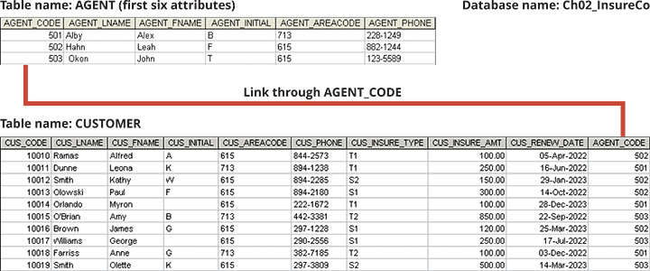
The Relational Model (2 of 4)
Figure 2.1 Linking Relational Tables

Slide 18
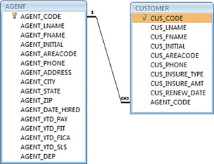
The Relational Model (3 of 4)
Figure 2.2 A Relational Diagram

Slide 19
The Relational Model (4 of 4)
Any SQL-based relational database application involves the following three parts:
The end user interface – the interface allows the end user to interact with the data
A collection of tables stored in the database – the tables “present” the data to the end user in a way that is easy to understand
SQL engine – the SQL engine executes all queries or data requests

Slide 20
The Entity Relationship Model (1 of 3)
Complex design activities require conceptual simplicity to yield successful results
Database designers prefer to use a graphical tool in which entities and their relationships are pictured
The entity relationship (ER) model (ERM) was developed to do just that
The relational data model and ERM combined to provide the foundation for tightly structured database design
An entity relationship diagram (ERD) uses graphical representations to model database components

Slide 21
The Entity Relationship Model (2 of 3)
The ER model is based on the following components:
Entity – an entity is represented in the ERD by a rectangle (entity box)
Attributes – each entity consists of a set of attributes that describes particular characteristics of the entity
Relationships – relationships describe associations among data
The following are three ER notations:
Chen notation
Crow’s Foot notation
Class diagram notation (part of the Unified Modeling Language (UML))

Slide 22
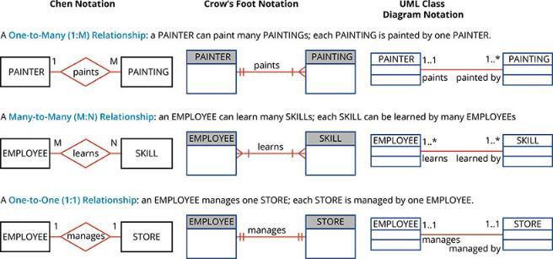
The Entity Relationship Model (3 of 3)
Figure 2.3 The ER Model Notations

Slide 23
The Object-Oriented Model (1 of 3)
In the object-oriented data model (OODM), both data and its relationship are contained in a single structure known as an object
The OODM is the basis for the object-oriented database management system (OODBMS)
The OODM is said to be a semantic data model because semantic indicates meaning
The OODM is based on the following components:
An object is an abstraction of a real-world entity
Attributes describe the properties of an object

Slide 24
The Object-Oriented Model (2 of 3)
The OODM is based on the following components (continued):
A class is a collection of similar objects with shared structure and behavior
A class’s method represents a real-world action such as finding a selected PERSON’s name, changing a PERSON’s name, or printing a PERSON’s address
The class hierarchy resembles an upside-down tree where each class has only one parent
Inheritance is the ability of an object within the class hierarchy to inherit the attributes and methods of the classes above it
Object-oriented data models are typically depicted using Unified Modeling Language (UML) class diagrams

Slide 25
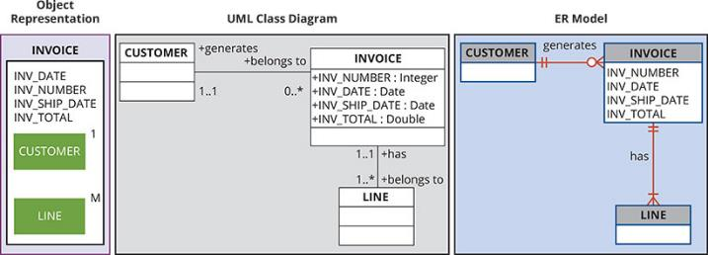
The Object-Oriented Model (3 of 3)
Figure 2.4 A Comparison of the OO, UML, and ER Models

Slide 26
Object/Relational and XML
The extended relational data model (ERDM) adds many of the OO model’s features within the simpler relational database structure
A DBMS based on the ERDM is often described as an object/relational database management system (O/R DBMS)
The success of the O/R DBMSs can be attributed to the model’s conceptual simplicity, data integrity, easy-to-use query language, high transaction performance, high availability, security, scalability, and expandability
The Extensible Markup Language (XML) has emerged as a standard for the efficient and effective exchange of structured, semistructured, and unstructured data

Slide 27
Emerging Data Models: Big Data and NoSQL (1 of 3)
Internet of Things (IoT) is a web of Internet-connected devices exchanging and collecting data
The IoT has accelerated the rate of data growth so that about 2.5 quintillion bytes of data are created daily
Big Data refers to a movement to find new and better ways to manage large amounts of web- and sensor-generated data and derive business insight from it
A basic characteristic of Big Data databases can be described as volume, velocity, and variety, or the 3 Vs

Slide 28
Emerging Data Models: Big Data and NoSQL (2 of 3)
Some of the most frequently used Big Data technologies are Hadoop and NoSQL databases:
Hadoop is a Java-based, open-source, high-speed, fault-tolerant distributed storage and computational framework
Hadoop Distributed File System (HDFS) is a highly distributed, fault-tolerant file storage system designed to manage large amounts of data at high speeds
MapReduce is an open-source application programming interface (API) that provides fast data analytics services
NoSQL is a large-scale distributed database system that stores structured and unstructured data in efficient ways

Slide 29
Emerging Data Models: Big Data and NoSQL (3 of 3)
NoSQL databases have the following general characteristics:
They are not based on the relational model and SQL
They support highly distributed database architectures
They provide high scalability, high availability, and fault tolerance
They support very large amounts of sparse data
They are geared toward performance rather than transaction consistency

Slide 30
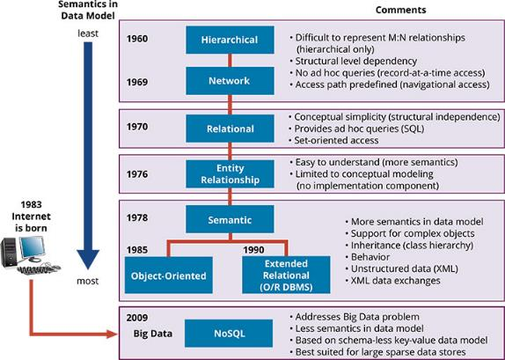
Data Models: A Summary
Figure 2.5 The Evolution of Data Models

Slide 31
Knowledge Check Activity 2-2
What does the term “3 Vs” refers to?

Slide 32
Knowledge Check Activity 2-2: Answer
What does the term “3 Vs” refers to?
Answer: The term “3 Vs” refers to the 3 basic characteristics of Big Data databases, they are: volume, velocity, variety.

Slide 33
Degrees of Data Abstraction (1 of 2)
The American National Standards Institute (ANSI) Standards Planning and Requirements Committee (SPARC) defined a framework for data modeling based on degrees of data abstraction
The three levels of data abstraction are external, conceptual, and internal
In Figure 2.6, on the following slide, the ANSI/SPARC framework has been expanded with the addition of a physical model to explicitly address physical-level implementation details of the internal model

Slide 34
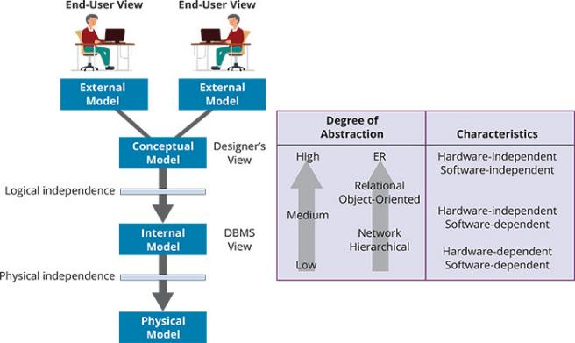
Degrees of Data Abstraction (2 of 2)
Figure 2.6 Data Abstraction Levels

Slide 35
The External Model (1 of 3)
The external model is the end users’ view of the data environment
End users usually operate in an environment in which an application has a specific business unit focus
End users within those business units view their data subsets as separate from or eternal to other units within the organization
ER diagrams will be used to represent the external views
A specific representation of an external view is known as an external schema

Slide 36
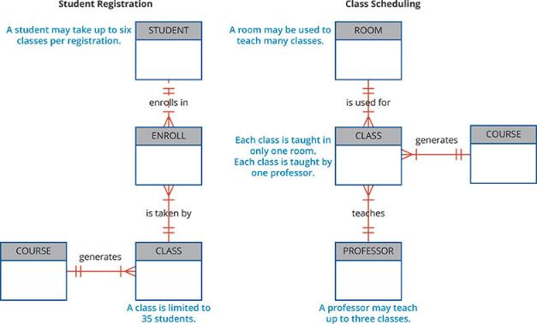
The External Model (2 of 3)
Figure 2.7 External Models for Tiny College

Slide 37
The External Model (3 of 3)
The use of external views that represent subsets of the database has some important advantages:
It is easy to identify specific data required to support each business unit
It makes the designer’s job easy by providing feedback about the model’s adequacy
It helps to ensure security constraints in the database design
It makes application program development much simpler

Slide 38
The Conceptual Model (1 of 2)
The conceptual model represents a global view of the entire database by the entire organization
Also known as a conceptual schema, it is the basis for the identification and high-level description of the main data objects
The most widely used conceptual model is the ER model
The following are advantages of the conceptual model:
It provides a bird’s-eye view of the data environment that is easy to understand
The conceptual model is independent of both software and hardware
The term logical design refers to creating a conceptual data model

Slide 39
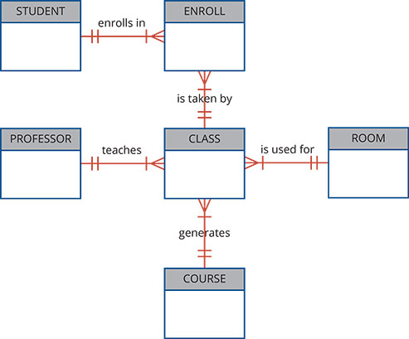
The Conceptual Model (2 of 2)
Figure 2.8 Conceptual Model for Tiny College

Slide 40
The Internal Model (1 of 2)
The internal model is the representation of the database as “seen” by the DBMS
The internal model requires a designer to match the conceptual model’s characteristics and constraints to those of the selected implementation model
An internal schema depicts a specific representation of an internal model, using the database constructs supported by the chosen database
Because the internal model depends on specific database software, it is said to be software dependent
When you change the internal model without affecting the conceptual model, you have logical independence
However, the internal model is still hardware independent

Slide 41
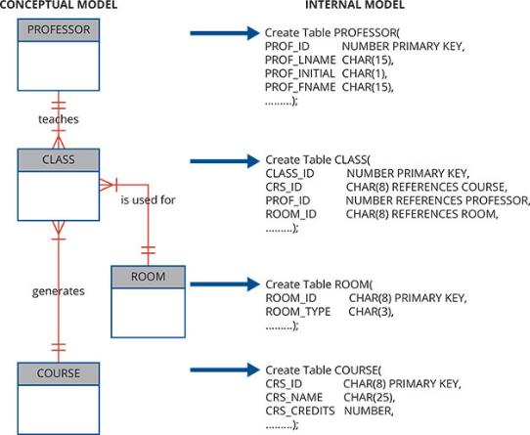
The Internal Model (2 of 2)
Figure 2.9 Internal Model for Tiny College

Slide 42
The Physical Model
The physical model operates at the lowest level of abstraction, describing the way data is saved on storage media
The physical model requires the definition of both the physical storage devices and the (physical) access methods required to reach the data within those storage devices
This means the physical model is both software and hardware dependent
When you can change the physical model without affecting the internal model, you have physical independence

Slide 43
Knowledge Check Activity 2-3
What is logical independence?

Slide 44
Knowledge Check Activity 2-3: Answer
What is logical independence?
Answer: Logical independence exists when you can change the internal model without affecting the conceptual model.

Slide 45
Summary
Now that the lesson has ended, you should be able to:
Discuss data modeling and why data models are important
Describe the basic data-modeling building blocks
Define what business rules are and how they influence database design
Understand how the major data models evolved
List emerging alternative data models and the needs they fulfill
Explain how data models can be classified by their level of abstraction

